Slide 1
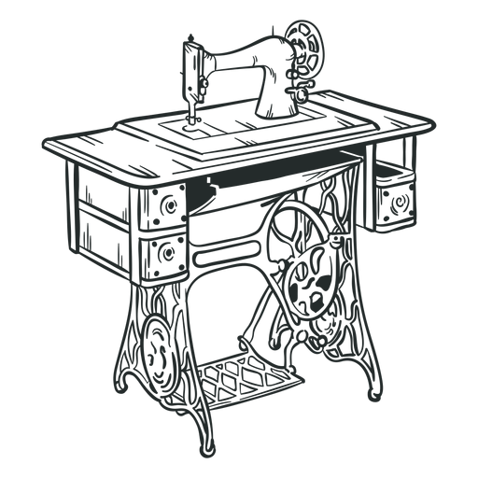
Ingrid’s Alterations
Asia Southerland, Whitley Anderson, Erin Adcock, Jordan Moser

Slide 2

History & Description
March 9th, 2023
Started with friends and family
Customers from everywhere
Apprentice at Atelier Di Stimamiglio Laura
Ingrid’s Alterations LLC

Slide 3
Current Environment
Manual records
No digital web page
Time
Ingrid’s Alterations LLC

Slide 4
Proposed System Objectives
Build an online presence
Streamline client communication
Highlight services offered and portfolio
Scheduling system
Helpful Links
Online payments
Ingrid’s Alterations LLC

Slide 5
Constraints
Updates
Budget
Client Resistance
Replacing previous workflow
Ingrid’s Alterations LLC

Slide 6
Expected Benefits
Enhanced communication
Easier booking process
Saving time
Helpful for clients
Improved professional image
Ingrid’s Alterations LLC

Slide 7
Problem Analysis
BPA (Business Process Automation)
Ingrid’s Alterations LLC

Slide 8
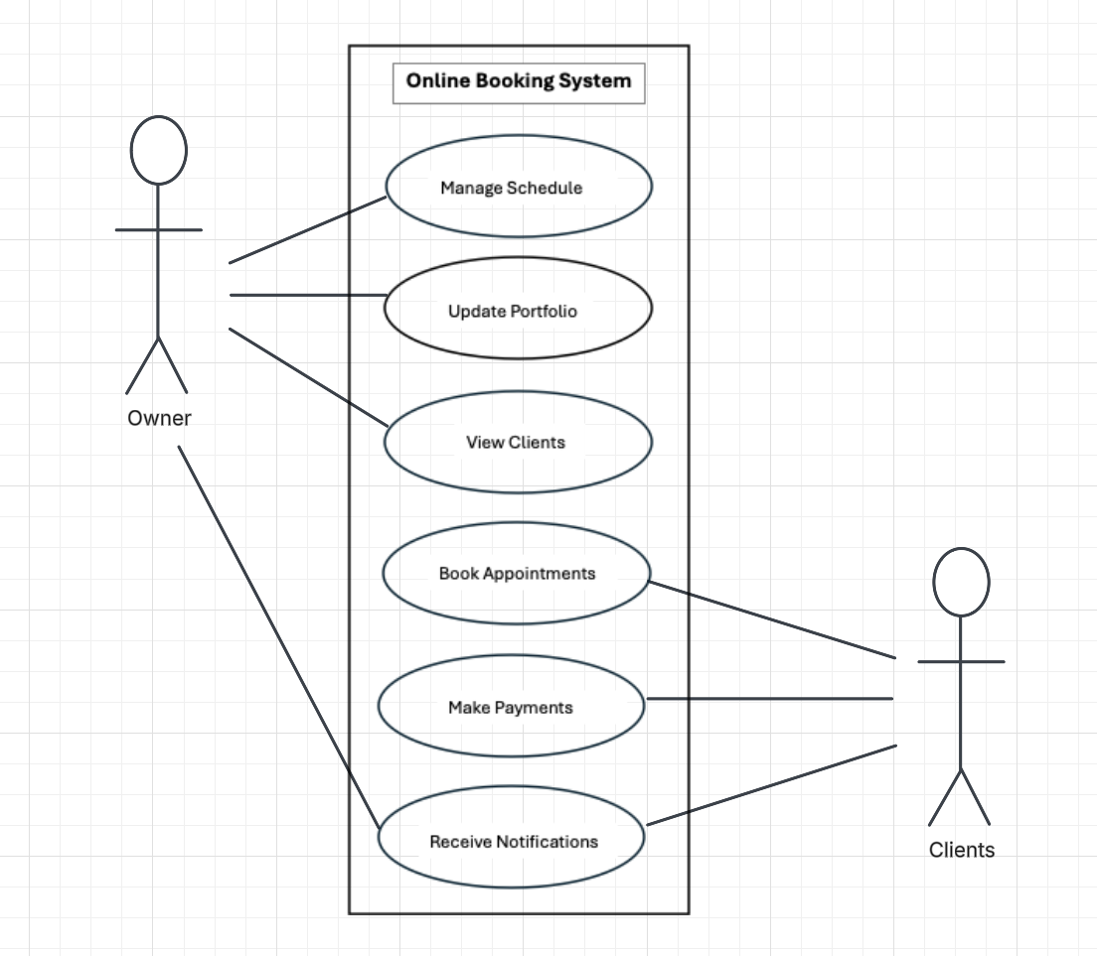

Slide 9
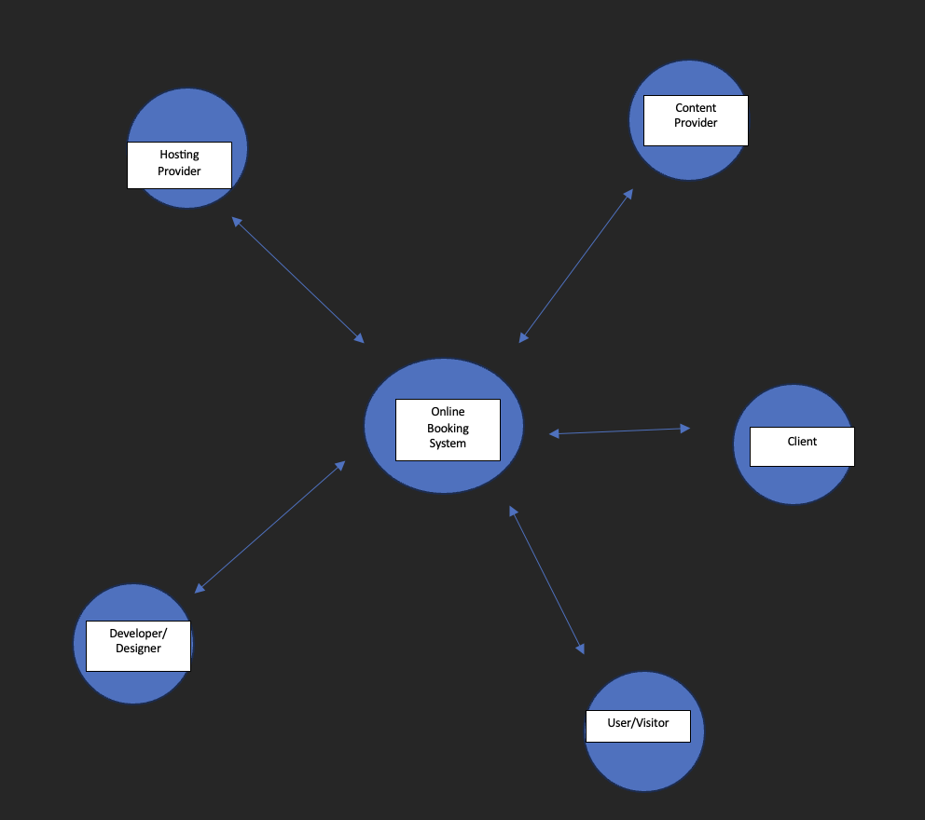

Slide 10
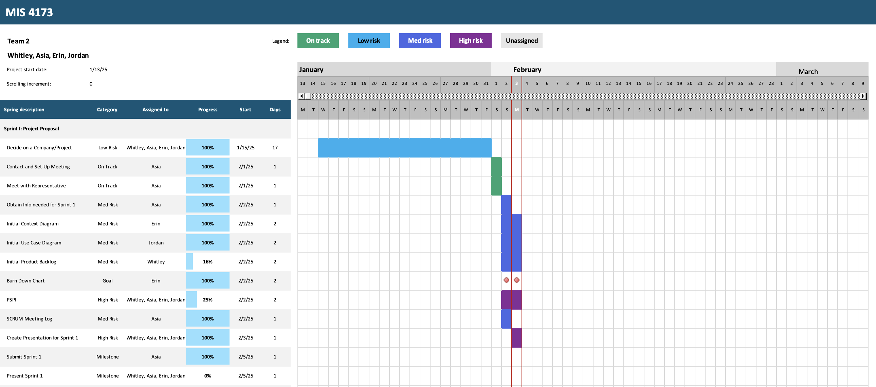

Slide 11
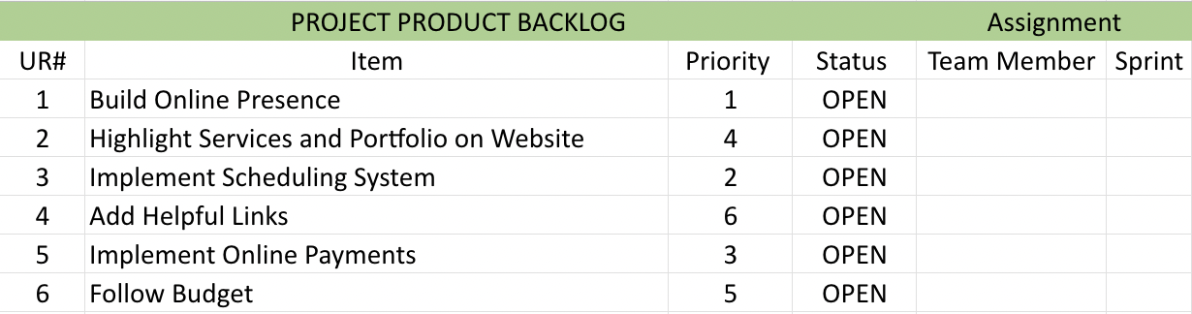
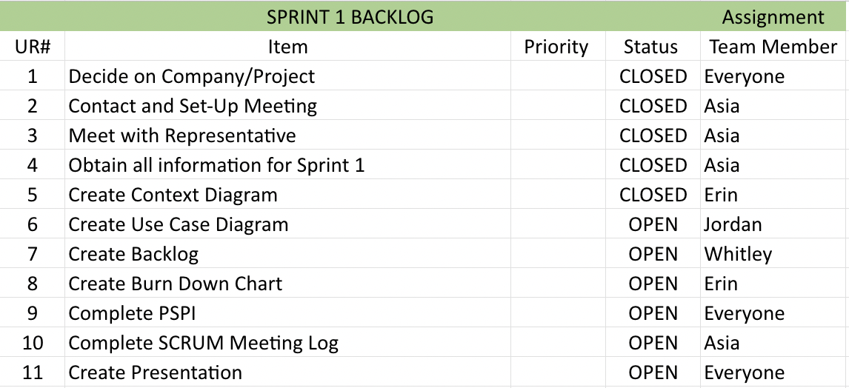

Slide 12
